Slide 1

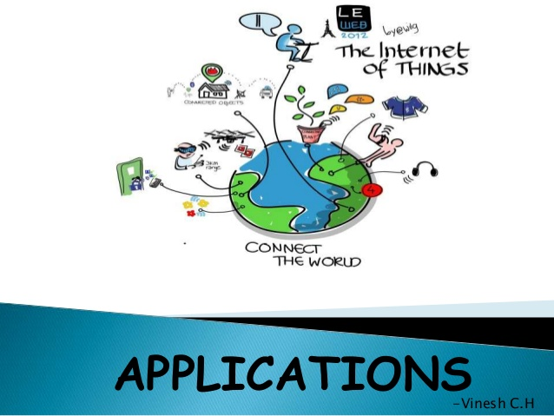
B.N.M. Institute of Technology Approved by AICTE, Affiliated to VTU, Accredited as grade A Institution by NAAC. All UG branches – CSE, ECE, EEE, ISE & Mech.E accredited by NBA for academic years 2018-19 to 2020-21 & valid upto 30.06.2021 Post box no. 7087, 27th cross, 12th Main, Banashankari 2nd Stage, Bengaluru- 560070, INDIA Ph: 91-80- 26711780/81/82 Email: principal@bnmit.in, www. bnmit.org
SKILL DEVELOPMENT PROGRAMME
on
Internet of Things
Organized by
Department of Computer Science & Engineering

Slide 2
Internet of Things (IoT)
What is Internet of Things?
History
How IoT Works?
Few Applications of IoT
Current Status & Future Prospect of IoT
Technological Challenges of IoT
Controversies of IoT

Slide 3
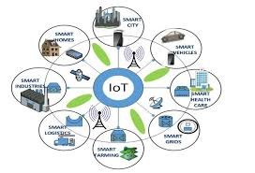
Introduction to Internet of Things (IoT)

Slide 4
What is IoT?
Internet of Things (IoT) is the network of physical objects or "things" embedded with electronics, software, sensors and network connectivity, which enables these objects to collect and exchange data.

Slide 5
"Things" in the IoT sense, can refer to a wide variety of devices such as heart monitoring system, biochip on farm animals, electric clams in coastal waters, automobiles with built-in sensors etc.,
These devices collect useful data with the help of various existing technologies and then autonomously flow the data between other devices.

Slide 6
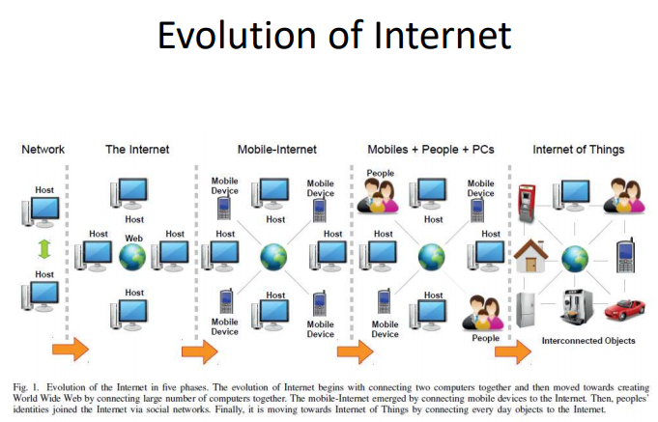

Slide 7
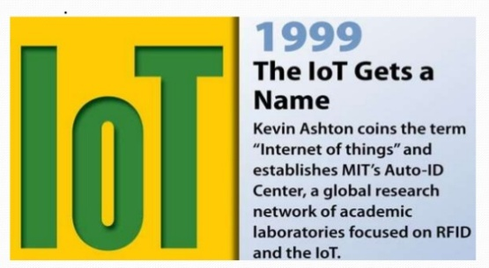
History of IoT

Slide 8
The concept of the Internet of Things first became popular in 1999, through the Auto-ID Center at MIT and related market-analysis publications.
Radio-frequency identification (RFID) was seen as a prerequisite for the IoT at that point. If all objects and people in daily life were equipped with identifiers, computers could manage them. Besides using RFID, the tagging of things may be achieved through such technologies as near field communication, barcodes, QR codes, bluetooth, and digital watermarking.

Slide 9
IoT Terminology
IoT
IoT Device
IoT Ecosystem
Entity
Remotes
Dashboard
Analytics
Data Storage
Network

Slide 10
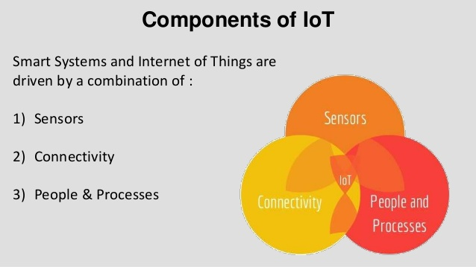
Components of IoT
Smart Systems and Internet of Things are driven by a combination of: Sensors, Connectivity, People and Processes.

Slide 11
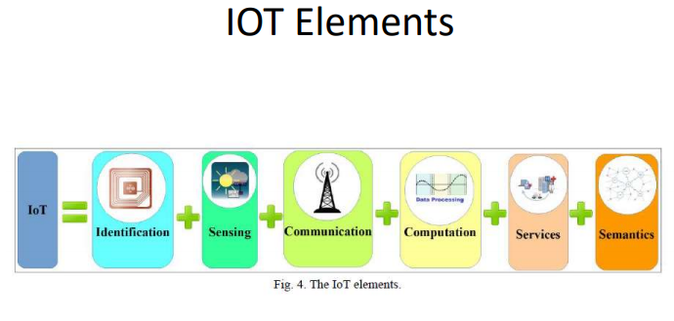

Slide 12
How IoT Works?
Internet of Things ( IoT) also sometimes referred to as the internet of everything (IoE), consists of all the web-enabled devices that collect, send and act on data they acquire from their surrounding environment using embedded sensors, processors and communication hardware.
These devices, often called “connected “ or “smart” devices, can sometimes talk to other related devices, a processes called machine-to-machine (M2M) communication, and act on the information they get from one another.

Slide 13
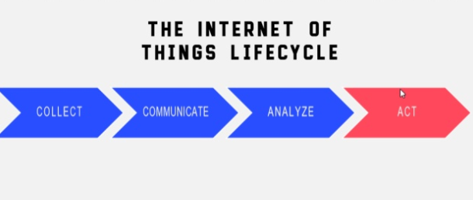

Slide 14
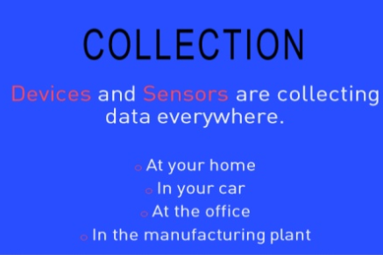

Slide 15
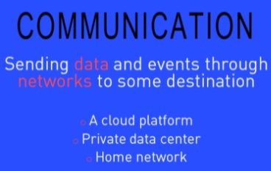

Slide 16
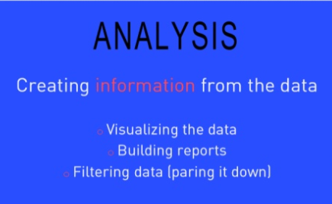

Slide 17
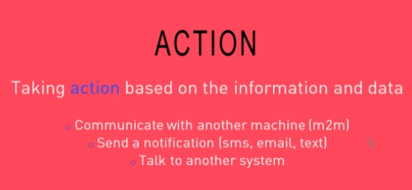

Slide 18
RFID
Sensor
Smart Tech
Nano Tech
To identify and track the data of things
To collect and process the data to detect the changes in the physical status of things
To enhance the power of the network by devolving processing capabilities to different part of the network.
To make the smaller and smaller things have the ability to connect and interact.

Slide 19
Structure of IoT
The IoT can be viewed as a vast network consisting of networks of devices and computers connected through a series of intermediate technologies where numerous technologies like RFIDs, wireless connections may act as enablers of this connectivity.

Slide 20
Tagging Things : Real-time item traceability and addressability by RFIDs.
Feeling Things : Sensors act as primary devices to collect data from the environment.
Shrinking Things : Miniaturization and Nanotechnology has provoked the ability of smaller things to interact and connect within the “things” or “smart devices.”
Thinking Things : Embedded intelligence in devices through sensors has formed the network connection to the Internet. It can make the “things” realizing the intelligent control.

Slide 21
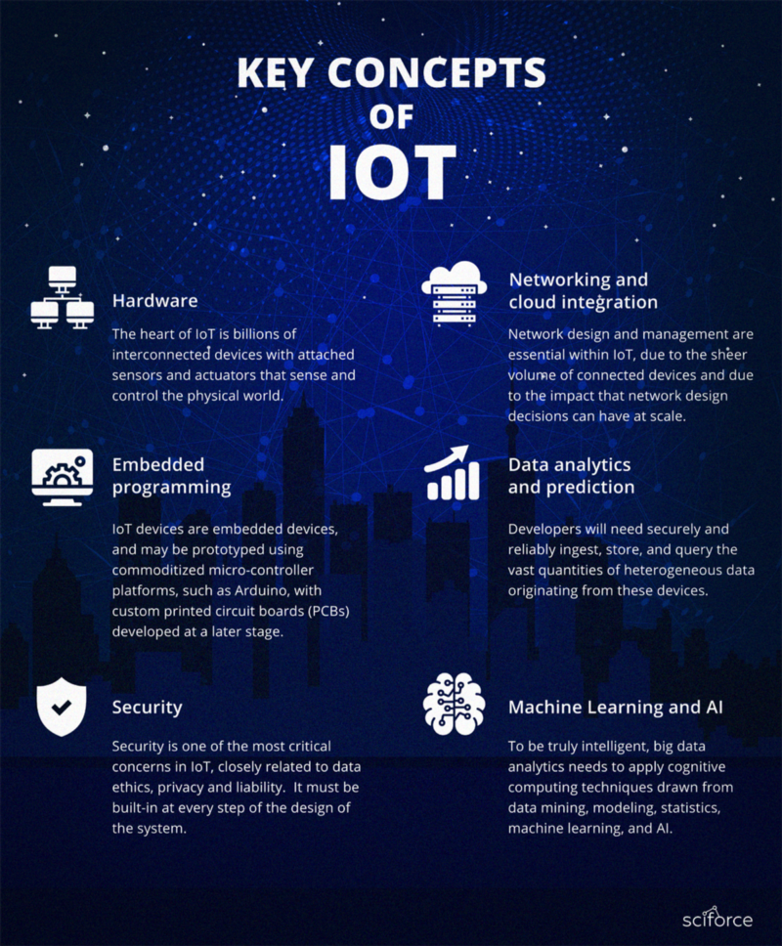
Key Concepts of IoT

Slide 22
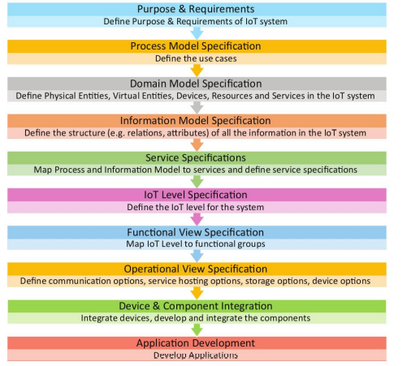
IoT Design Methodology

Slide 23
Few Applications of IoT
Building and Home automation
Manufacturing
Medical and Healthcare systems
Media
Environmental monitoring
Infrastructure management
Energy management
Transportation

Slide 24
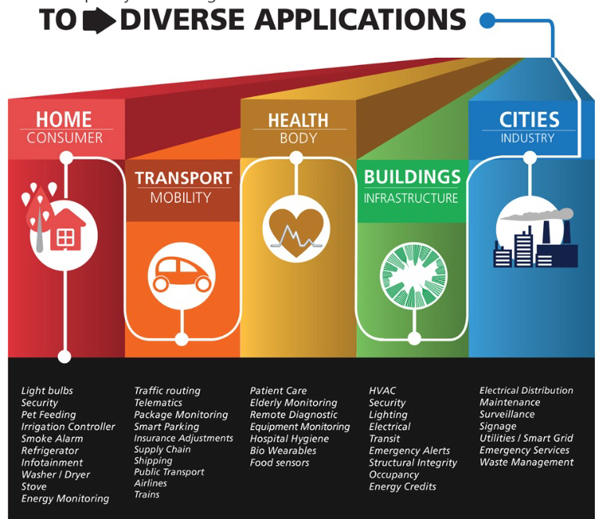

Slide 25
Current Status & Future Prospect of IoT

Slide 26
IoT as a Network of Networks:
These networks connected with added security, analytics, and management capabilities. This will allow IoT to become even more powerful in what it can help people achieve.

Slide 27
Technological Challenges of IoT
At present IoT is faced with many challenges;
Scalability
Technological Standardization
Inter operability
Software complexity
Data volumes and interpretation
Power Supply
Interaction and short range communication
Wireless communication
Fault tolerance

Slide 28
Criticisms &Controversies of IoT
Scholars and social observers and pessimists have doubts about the promises of the ubiquitous computing revolution, in the areas as:
Privacy
Security
Autonomy and Control
Social control
Political manipulation
Design
Environmental impact
Influences human moral decision making

Slide 29
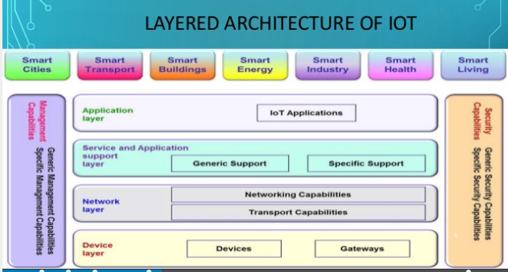

Slide 30
Overview of the Main Stages in the IoT Architecture Diagram
Sensors and actuators
Internet getaways and Data Acquisition Systems
Edge IT
Data center and cloud.

Slide 31
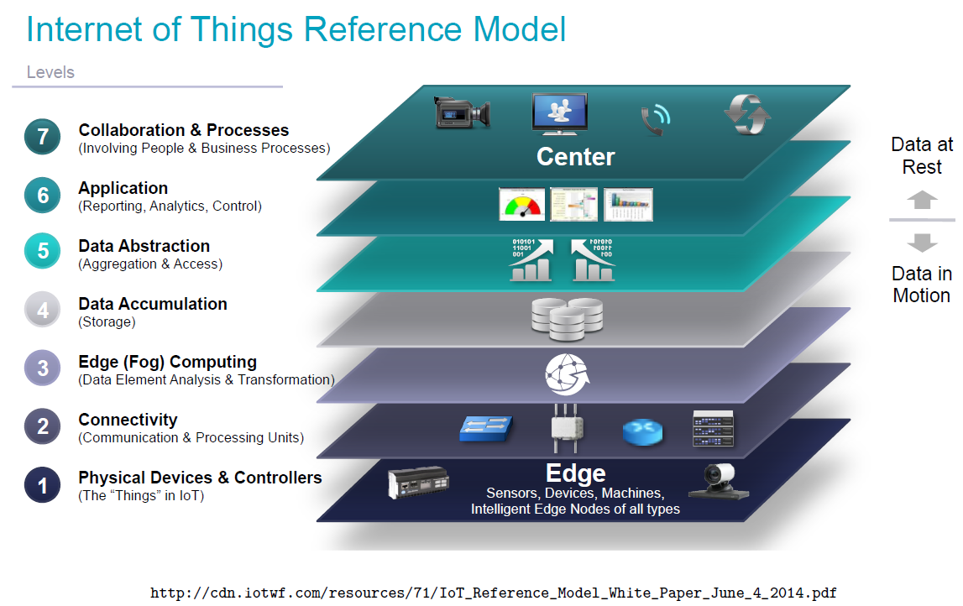

Slide 32
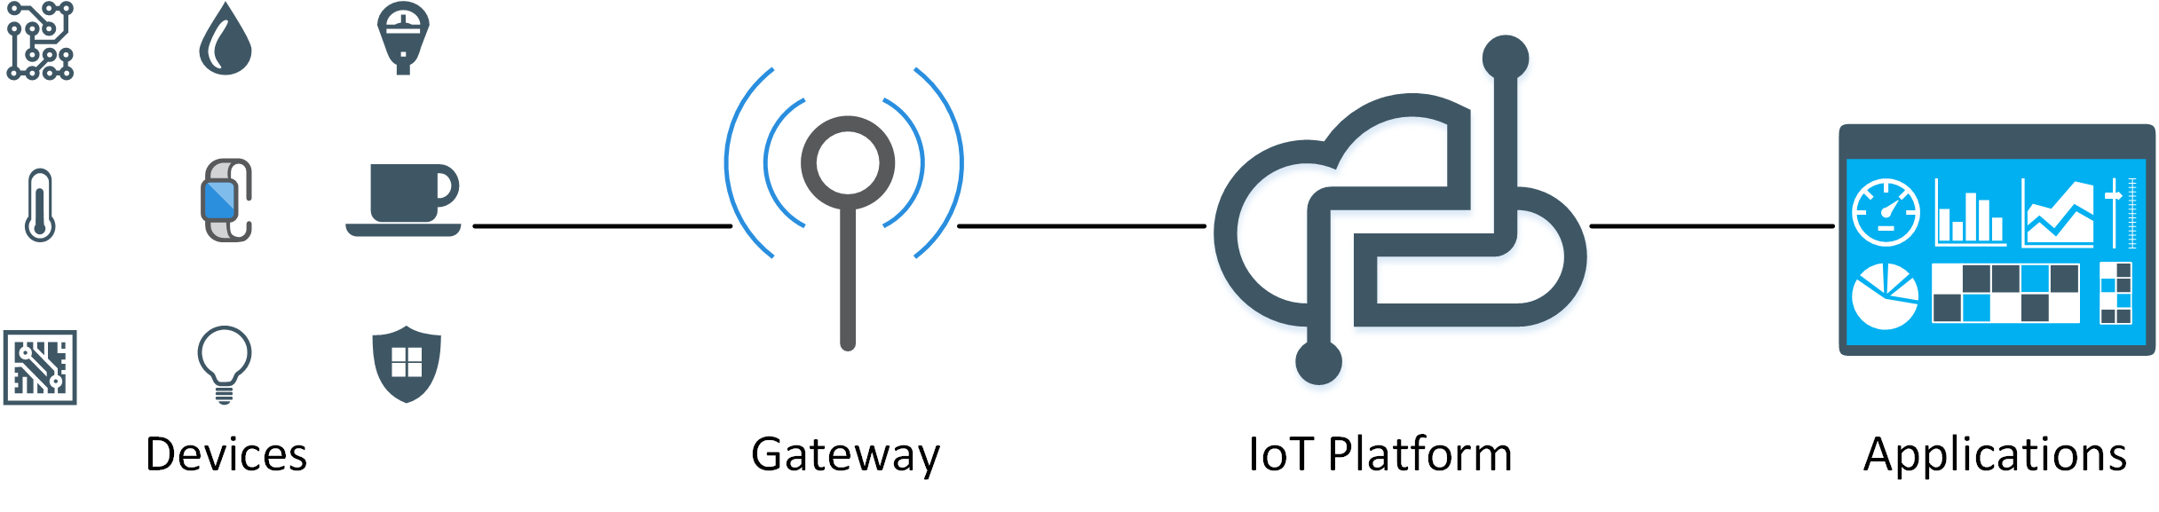
IoT Stack

Slide 33
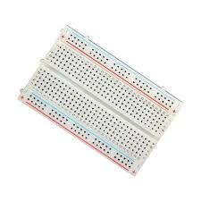
IoT components
The purpose of the breadboard is to make quick electrical connections between components- like resistors, LEDs, capacitors, etc- so that you can test your circuit before permanently soldering it together.
Bread Board

Slide 34
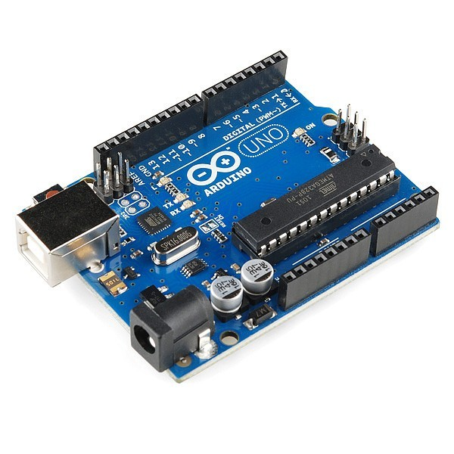
Arduino Uno

Slide 35
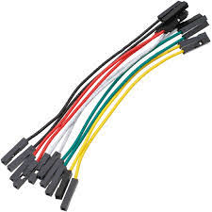
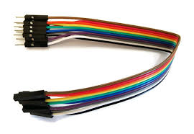
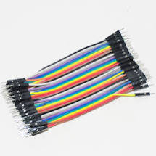
Jumper Wires

Slide 36
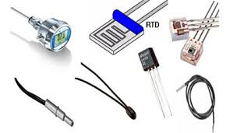
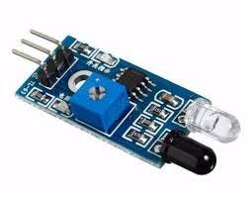
Different Types of Sensors

Slide 37
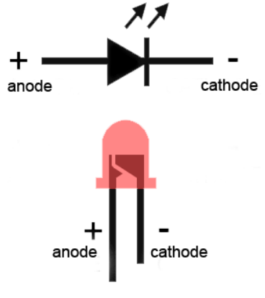
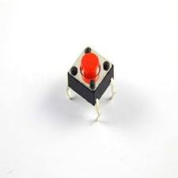
Tactile Switches
LED Lights

Slide 38
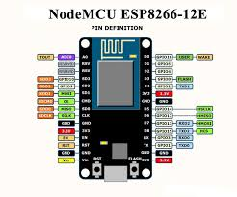
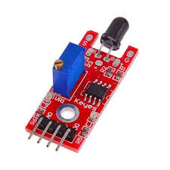
Flame Sensors

